Slide 1


Being hungry
Restaurant

Slide 2

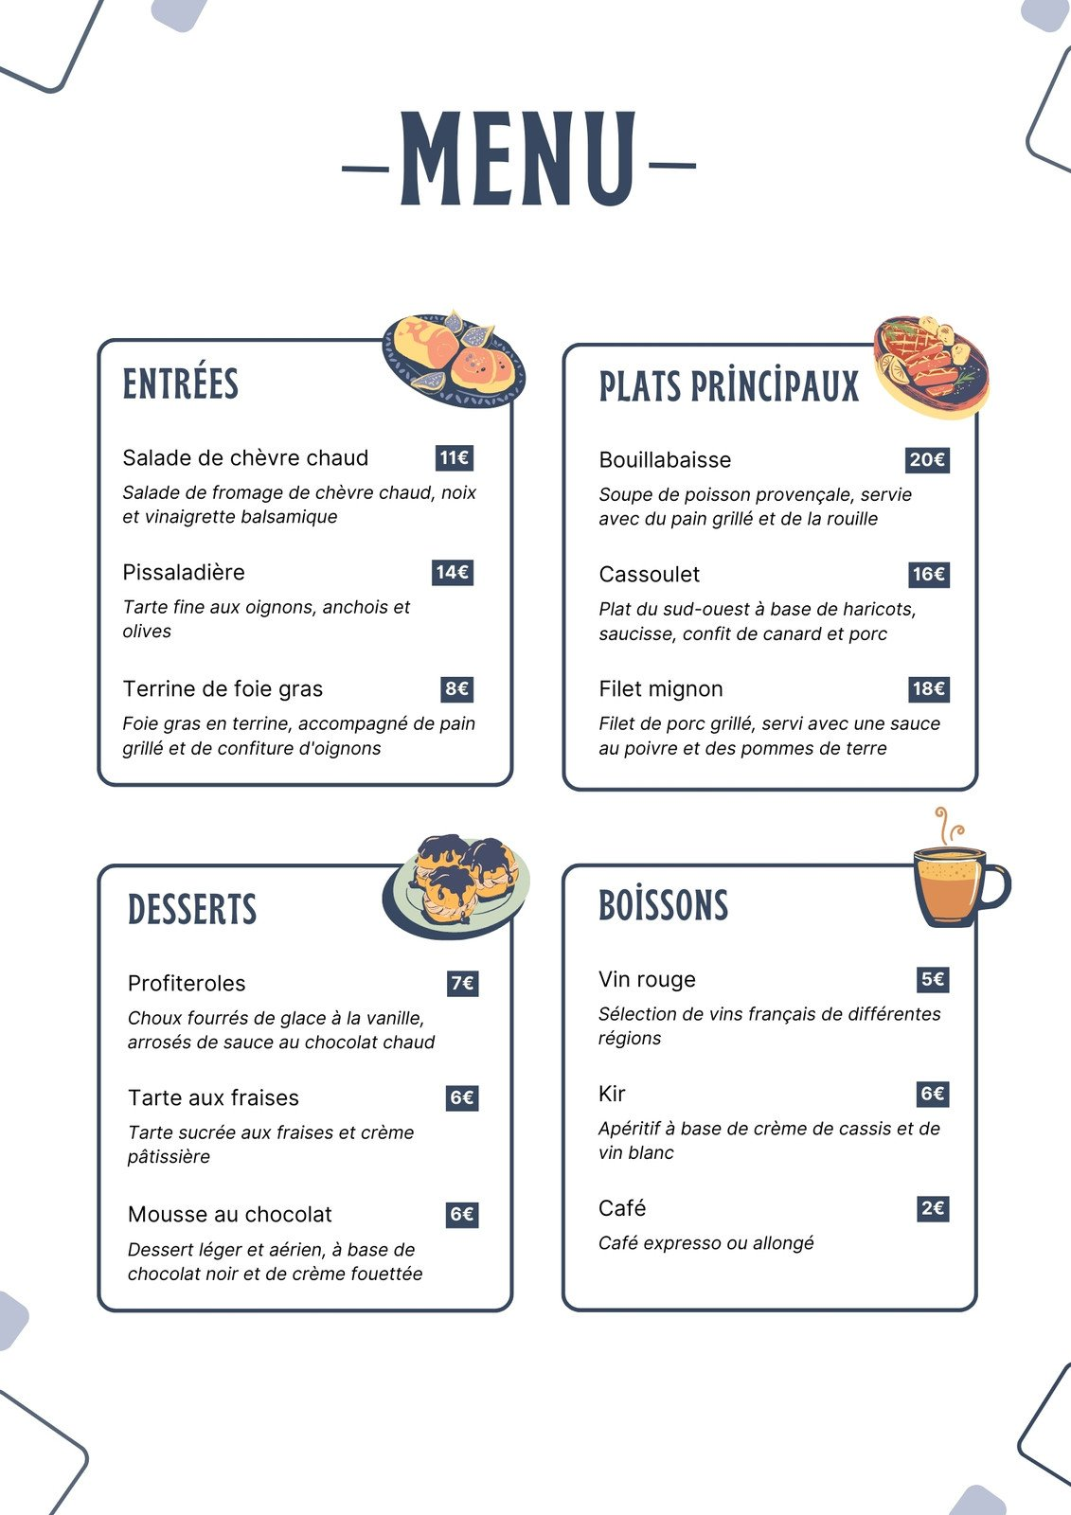
View
Menu is like an interface

Slide 3



Slide 4


Slide 5

Supplier (Interface)
Client (Class)
“what” dishes are available
"how" those dishes are actually made,
Realization
Declares a set of functionalities or operations (methods)
Implements those functionalities

Slide 6
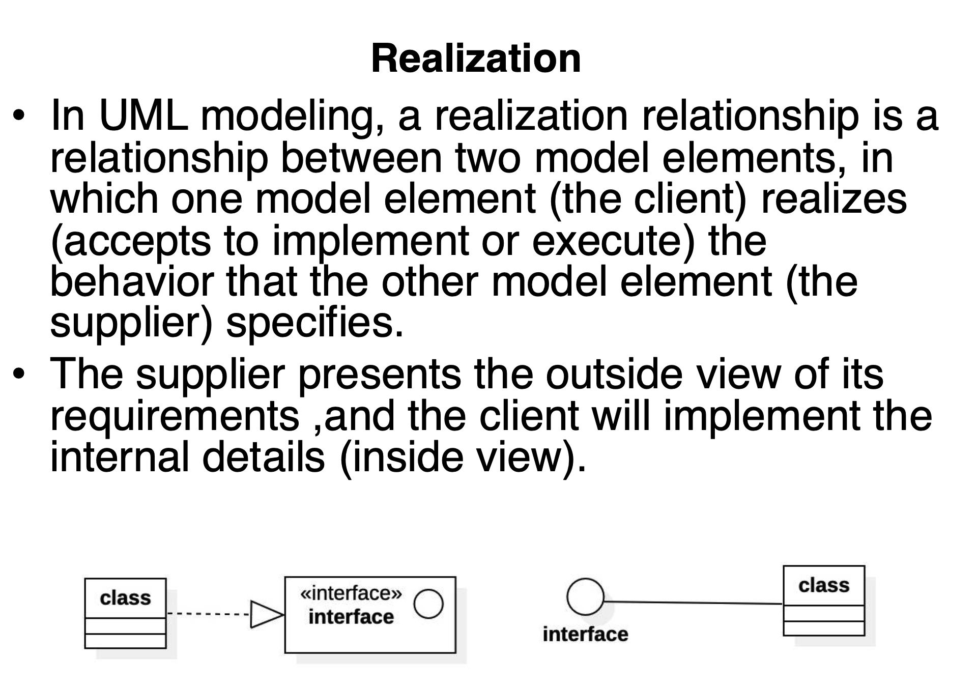

Slide 8
Why is Realization Important?
Abstraction
Flexibility & Extensibility
Decoupling

Slide 9
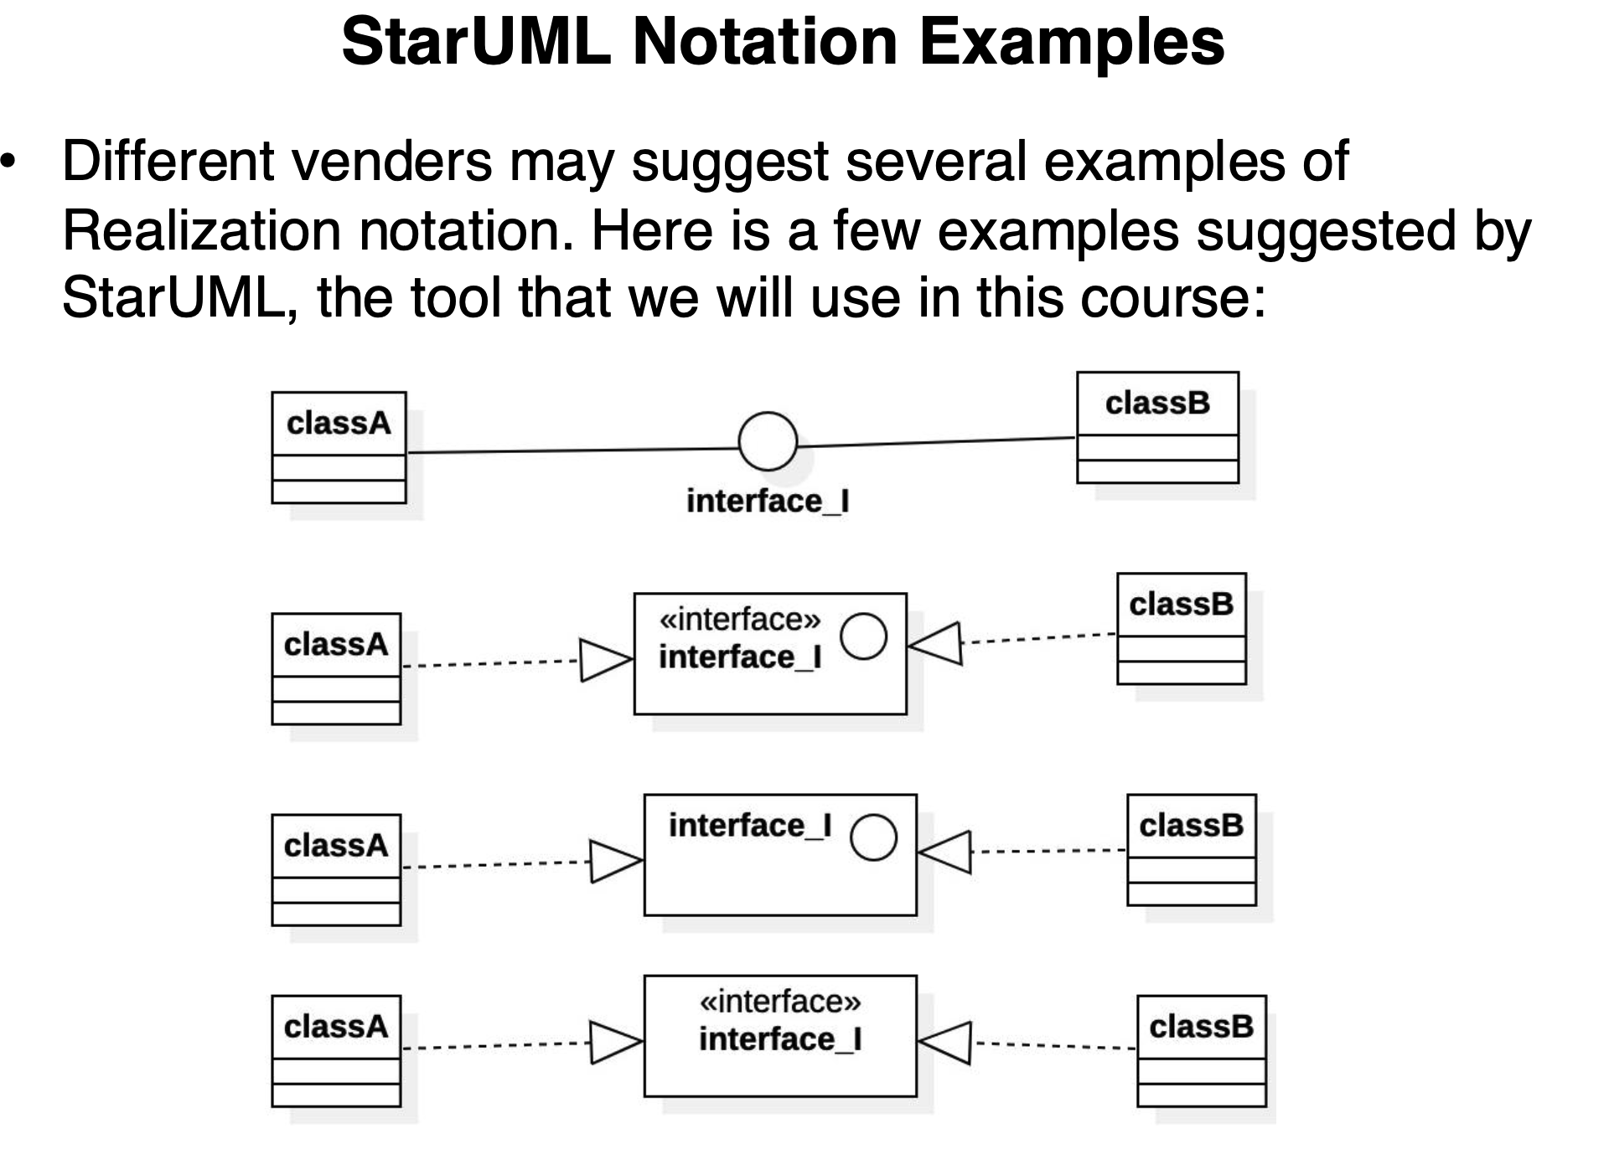
Ball-and-Socket Notation

Slide 10
Ball-and-Socket Notation
Boxed Interface and a
Hollow Arrow

Slide 11
Ball-and-Socket Notation
Boxed Interface and a
Hollow Arrow
Interface Circle Inside a Box

Slide 12
Ball-and-Socket Notation
Boxed Interface and a
Hollow Arrow
Interface Circle Inside a Box
Simplified Boxed
Interface

Slide 13
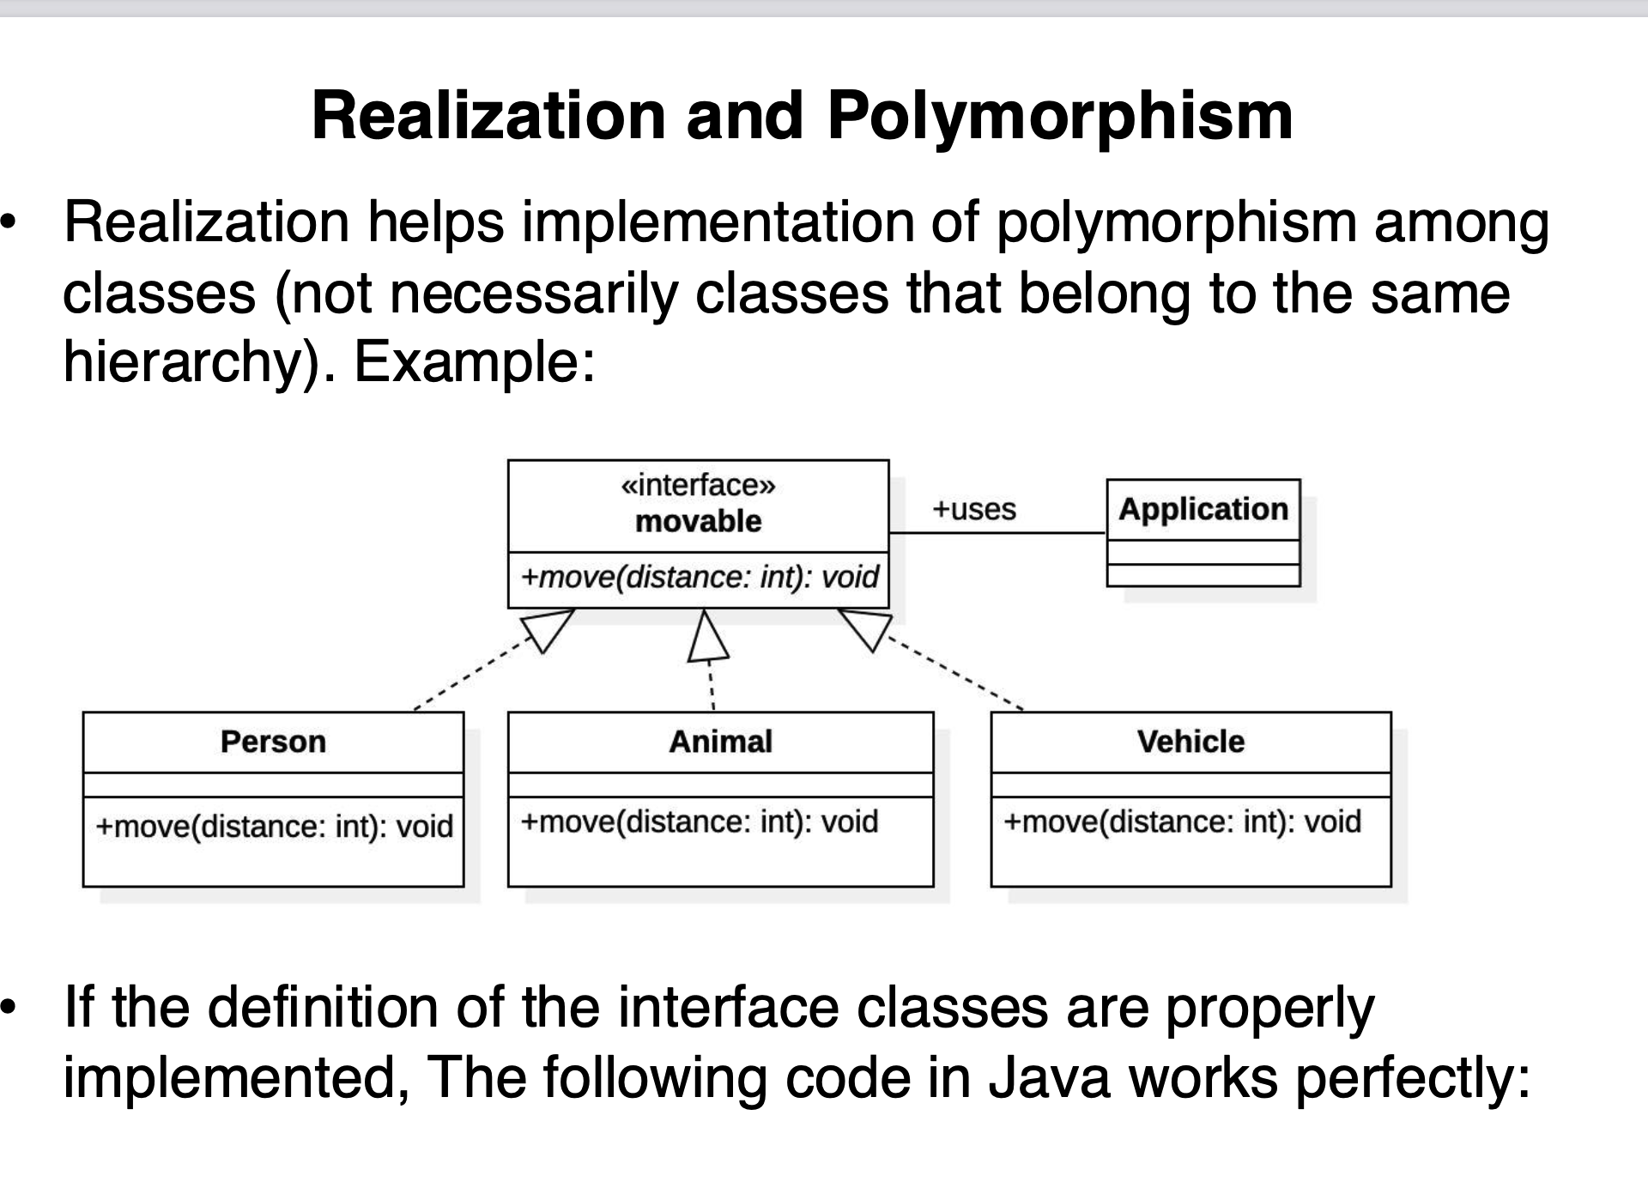

Slide 14
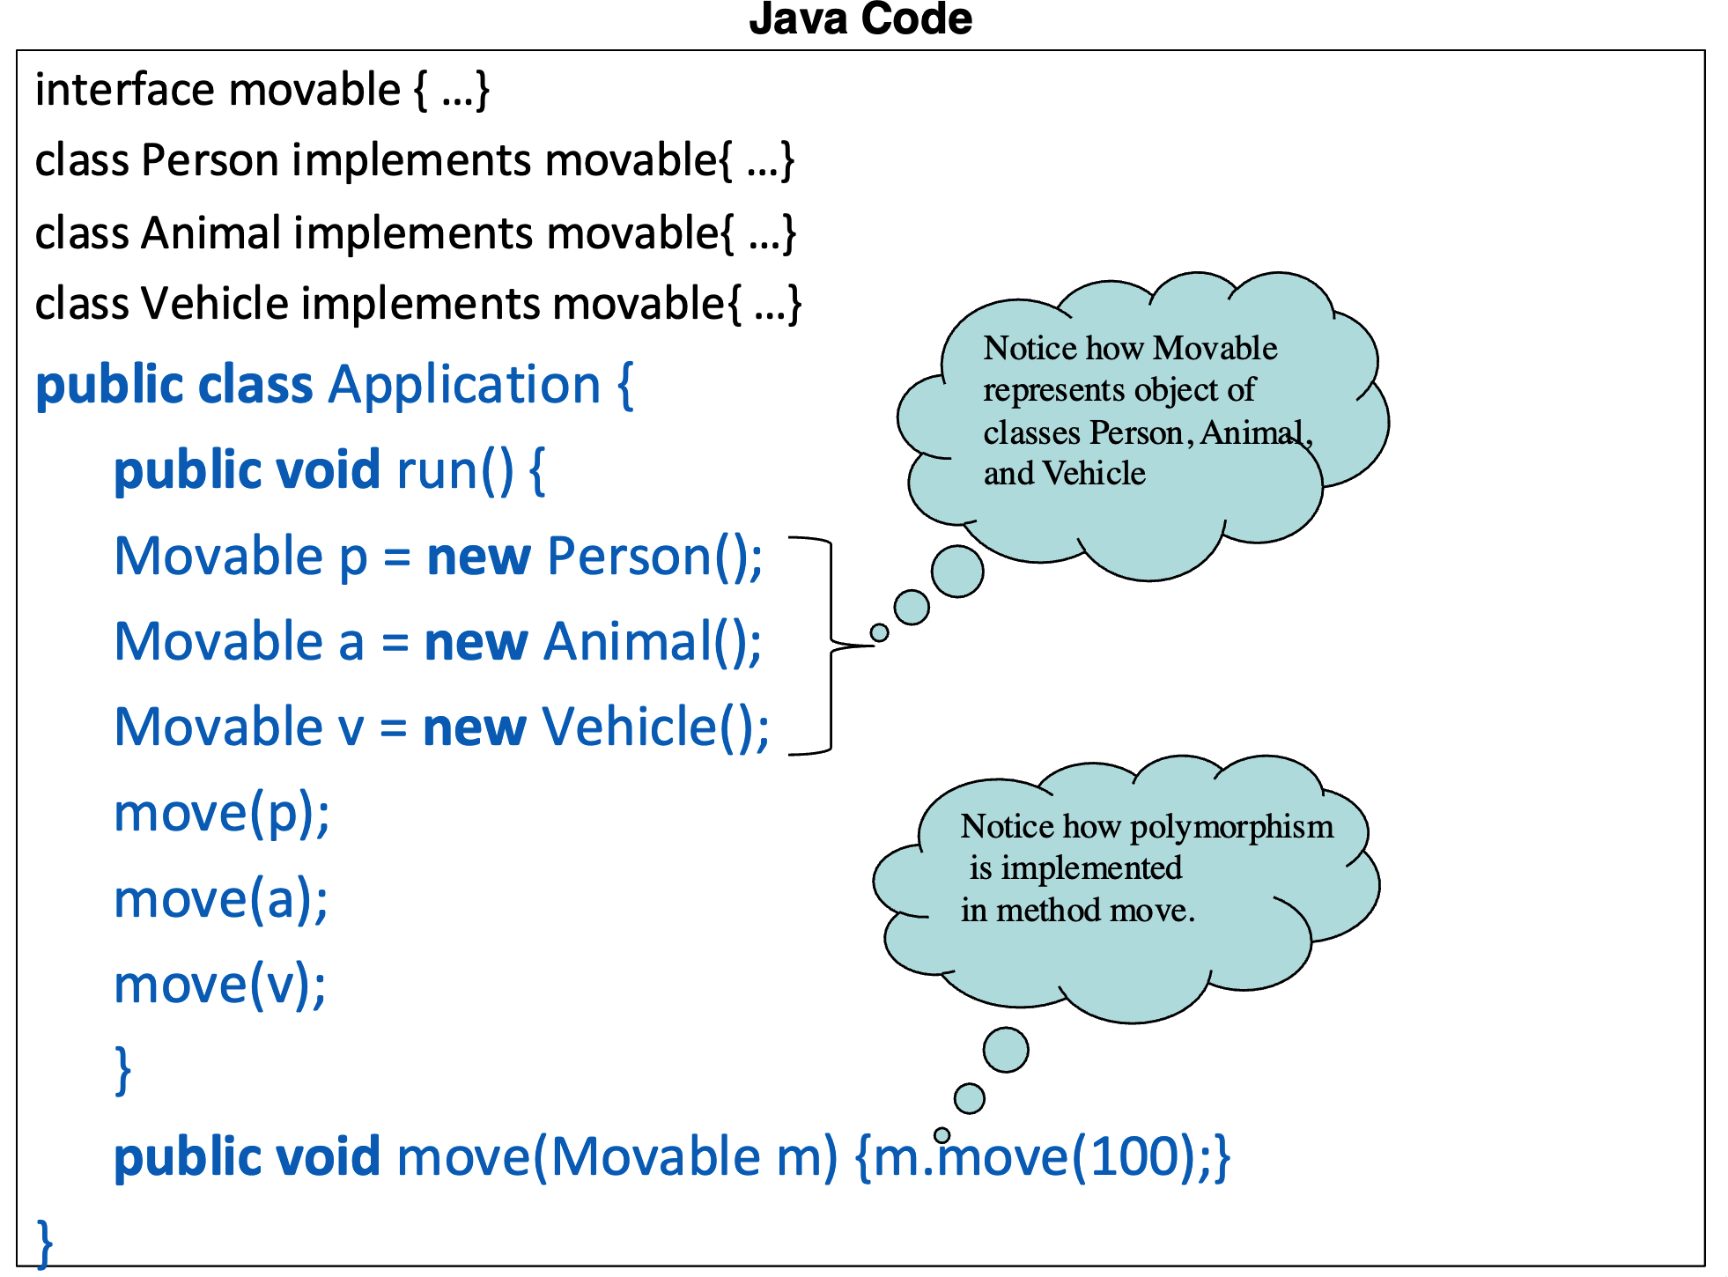

Slide 15
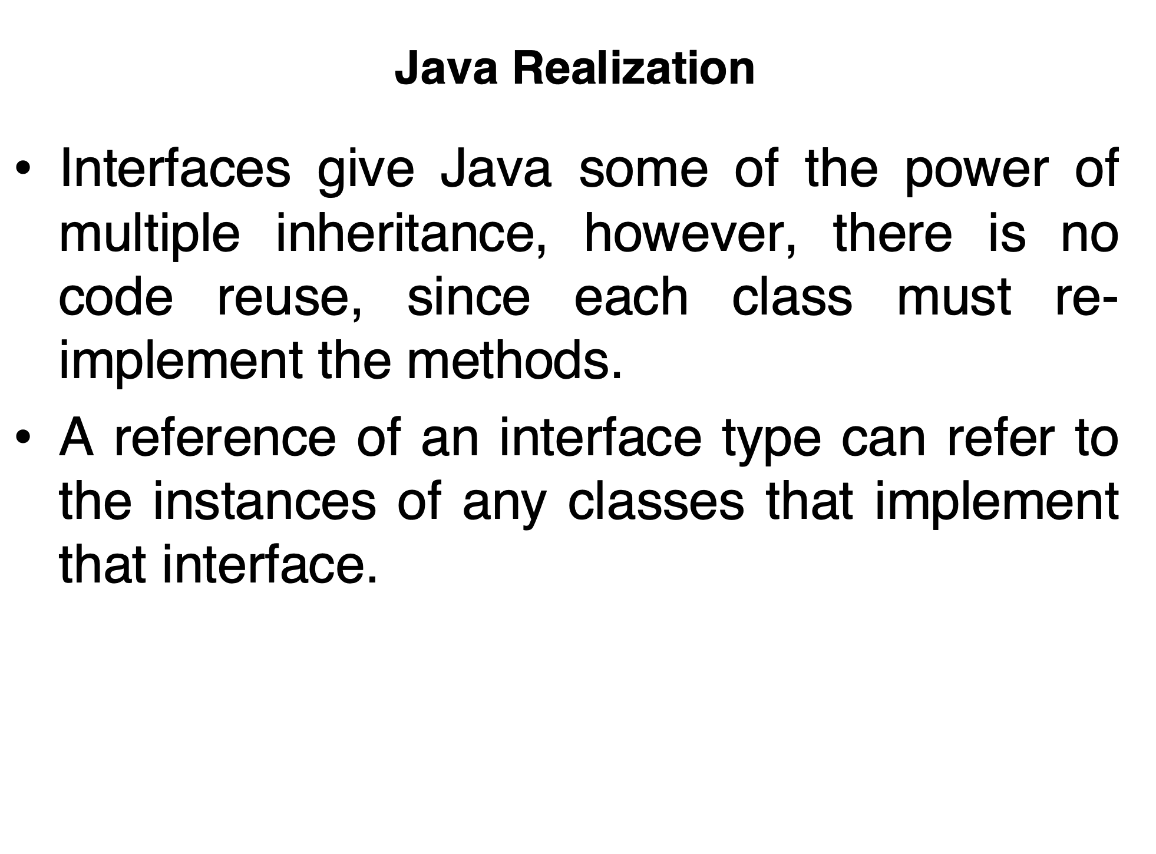

Slide 17
What is an Interface Reference?
An interface reference is a variable of the type of an interface.
interface Movable {
void move(int distance);
}
Movable m;
class Person implements Movable {
public void move(int distance) {
System.out.println("Person moves " + distance + " meters.");
}}
class Animal implements Movable {
public void move(int distance) {
System.out.println("Animal moves " + distance + " meters.");
}}
class Vehicle implements Movable {
public void move(int distance) {
System.out.println("Vehicle moves " + distance + " meters.");
}}
m = new Person(); // m now refers to a Person object
m.move(10); // Outputs: "Person moves 10 meters."
m = new Animal(); // m now refers to an Animal object
m.move(20); // Outputs: "Animal moves 20 meters."
m = new Vehicle(); // m now refers to a Vehicle object
m.move(50); // Outputs: "Vehicle moves 50 meters."

Slide 18
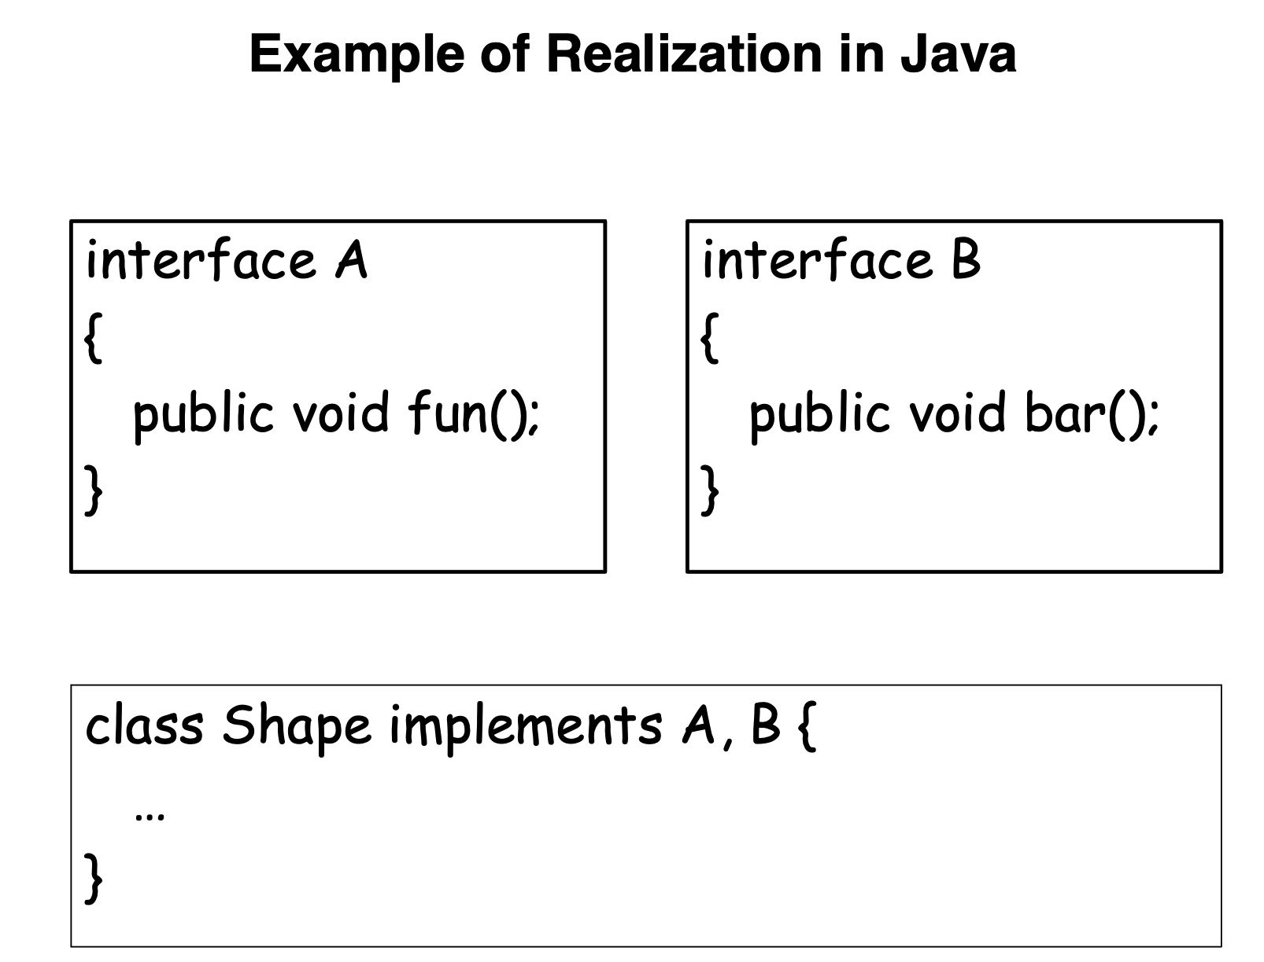

Slide 19
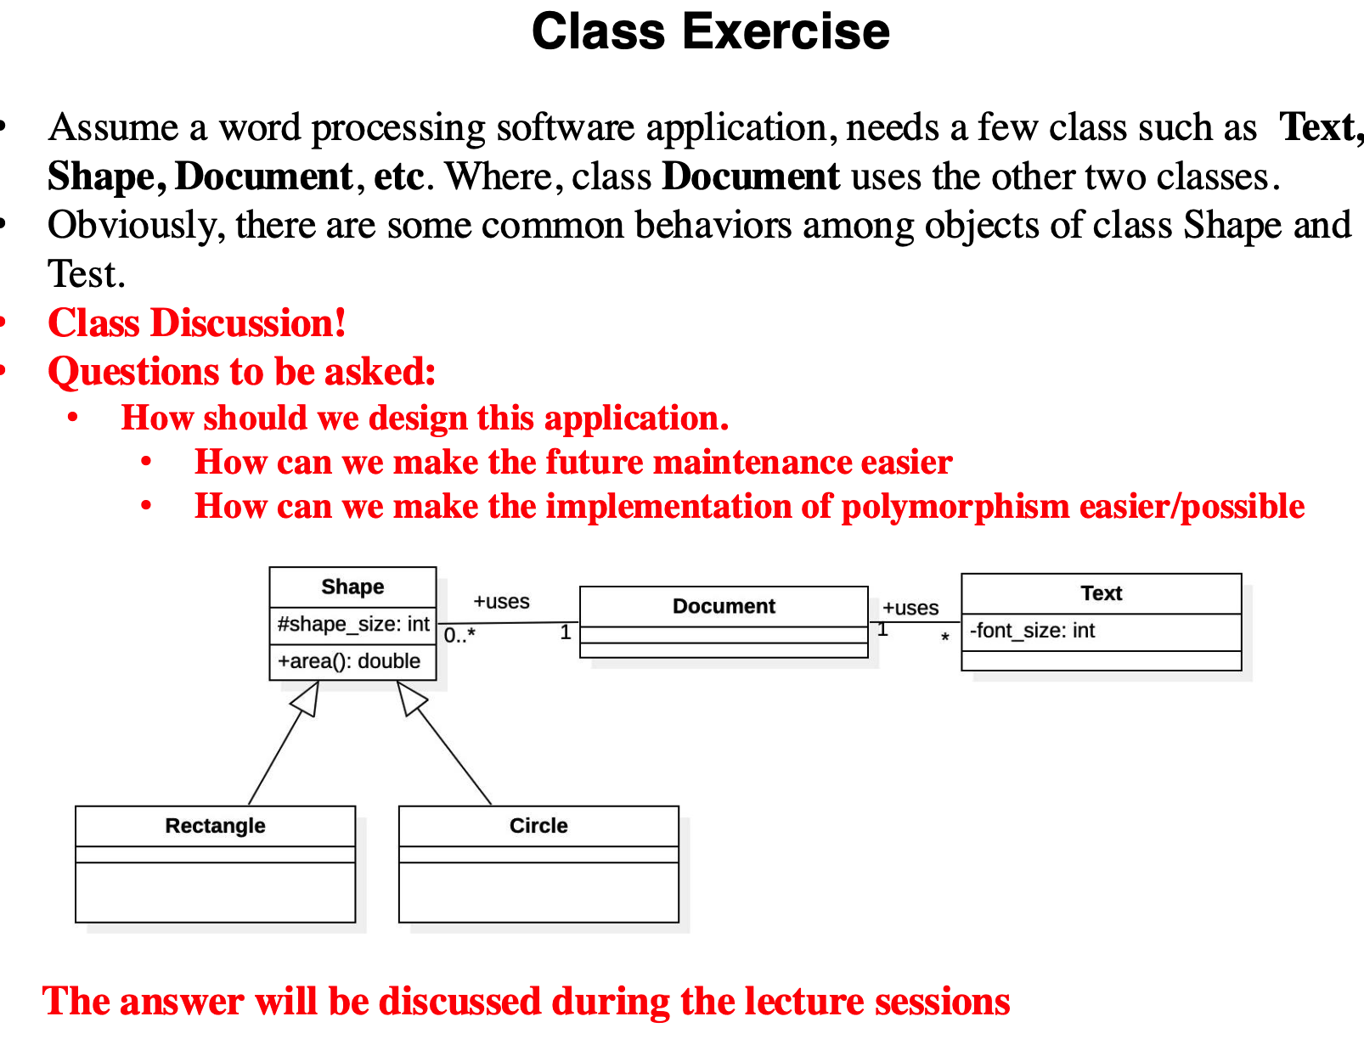

Slide 20
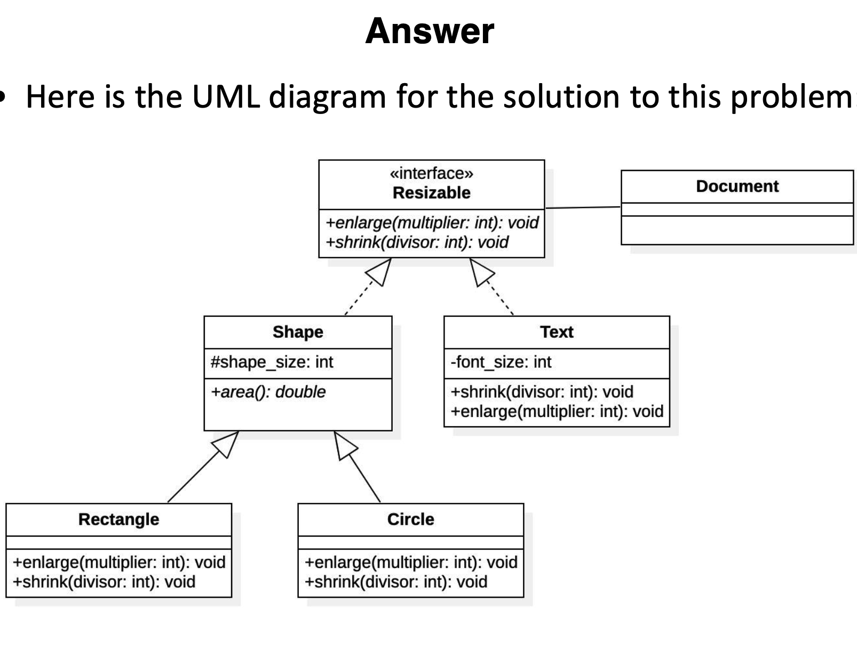

Slide 22
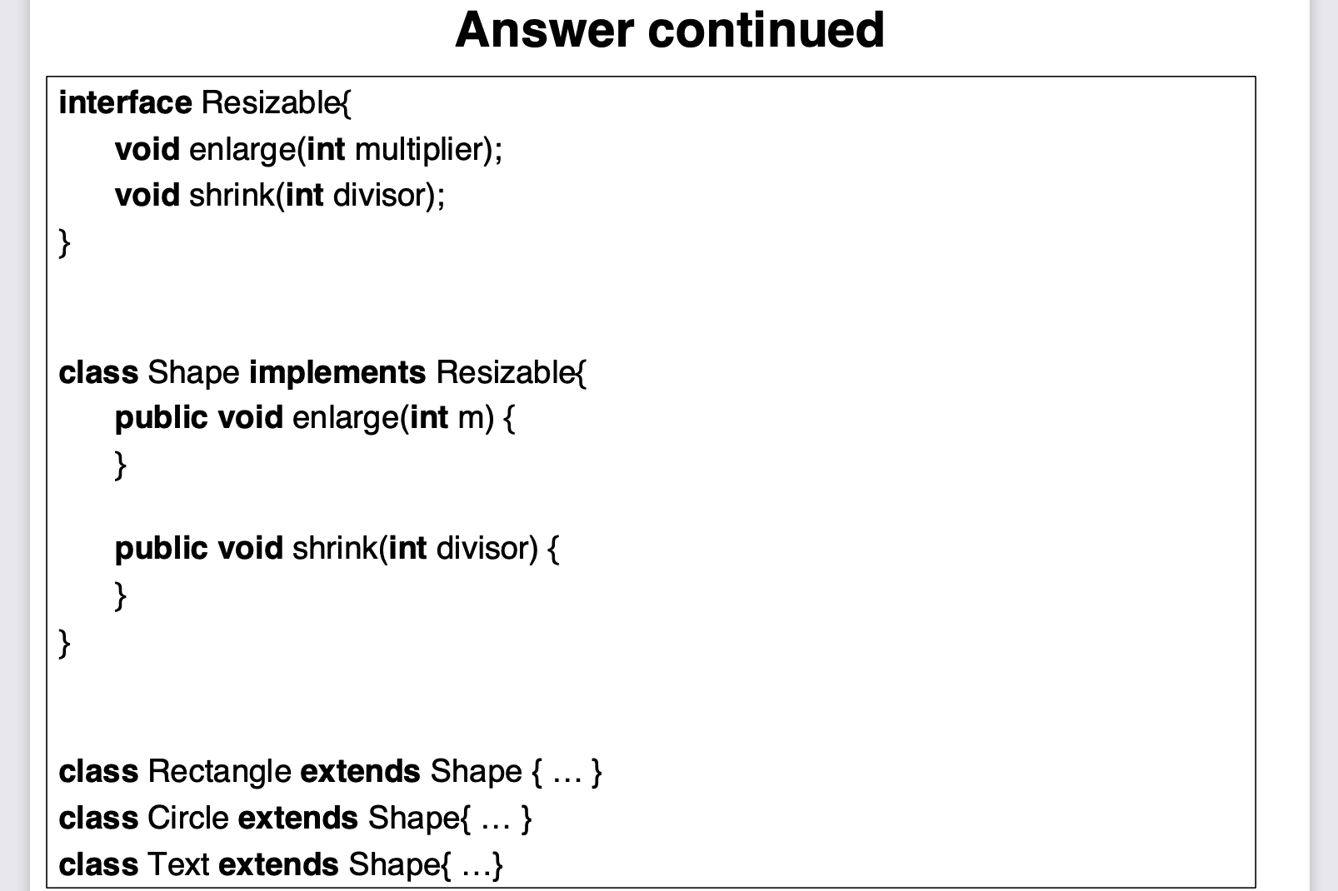

Slide 23
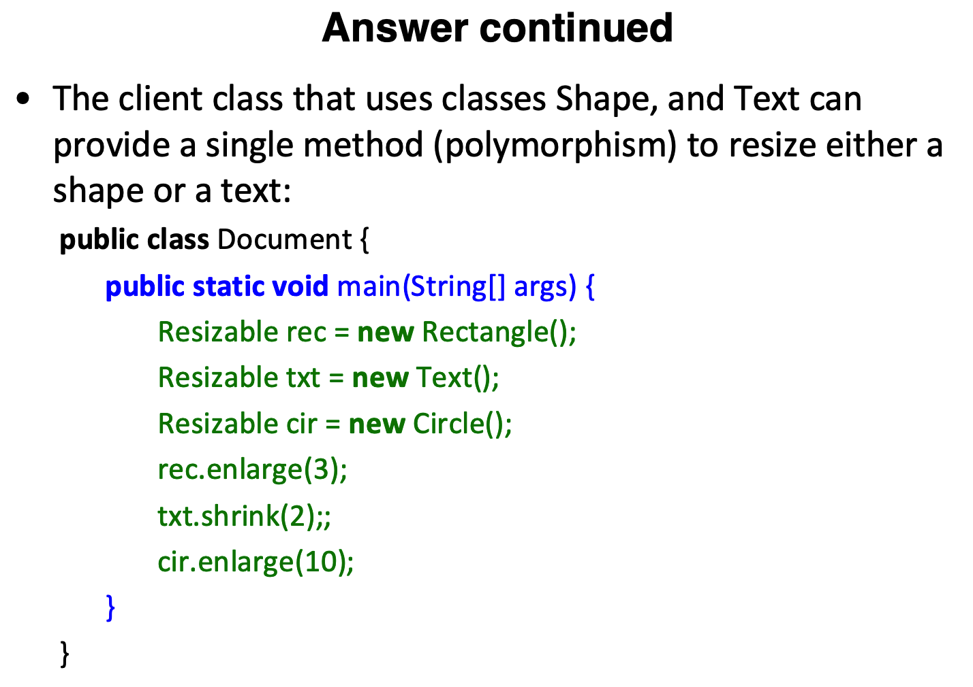

Slide 24
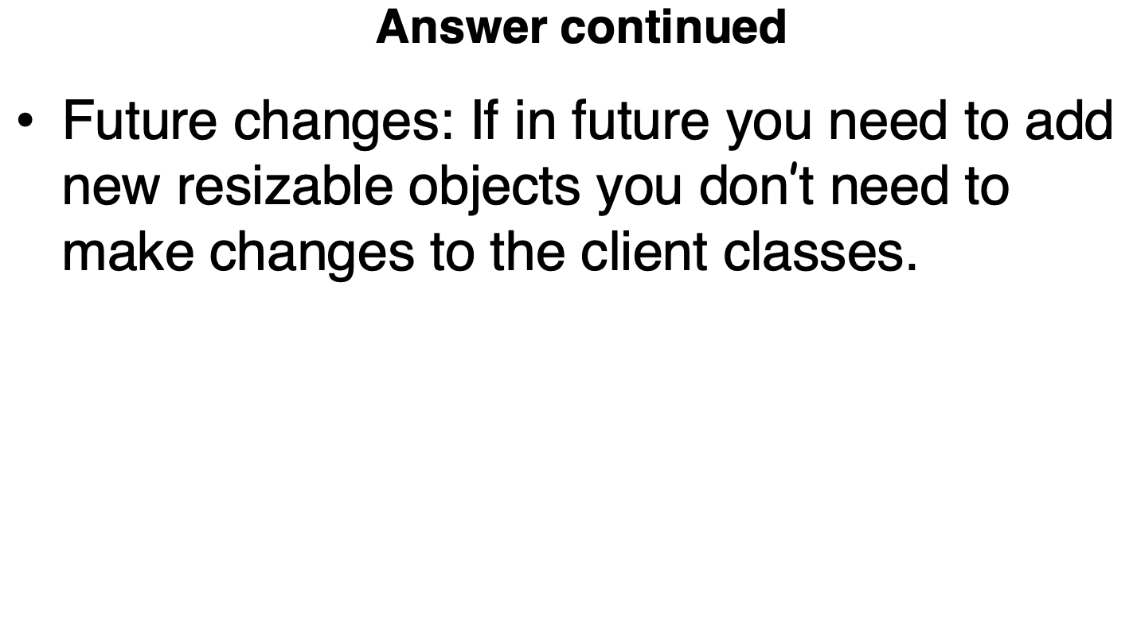

Slide 25
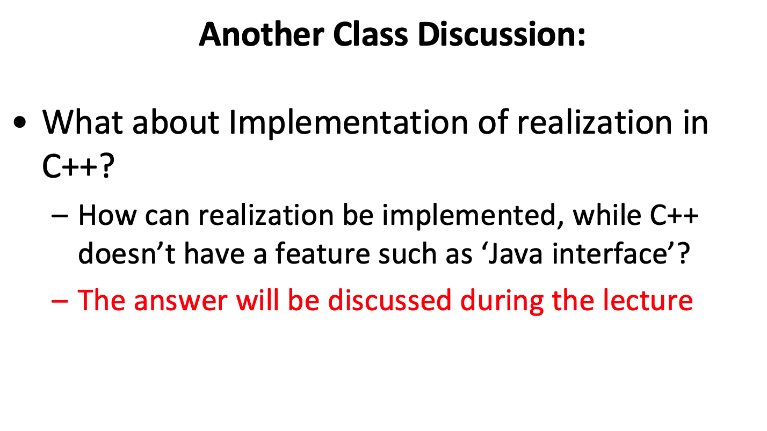

Slide 26
#include <iostream>
using namespace std;
// Abstract class (acts like an interface)
class Resizable {
public:
// Pure virtual function
virtual void enlarge(int multiplier) = 0;
virtual void shrink(int divisor) = 0;
};
// Another concrete class implementing Resizable
class Text : public Resizable {
public:
void enlarge(int multiplier) override {
cout << "Enlarging Text by " << multiplier << endl;
}
void shrink(int divisor) override {
cout << "Shrinking Text by " << divisor << endl;
}
};
int main() {
// Creating objects
Resizable* rec = new Rectangle();
Resizable* txt = new Text();
// Using the polymorphic interface
rec->enlarge(2); // Output: Enlarging Rectangle by 2
txt->shrink(3); // Output: Shrinking Text by 3
// Clean up
delete rec;
delete txt;
return 0;
}
// Concrete class that implements the Resizable interface
class Rectangle : public Resizable {
public:
void enlarge(int multiplier) override {
cout << "Enlarging Rectangle by " << multiplier << endl;
}
void shrink(int divisor) override {
cout << "Shrinking Rectangle by " << divisor << endl;
}
};

